Slide 1
Whole Heart Segmentation
ZHUANG, Xiahai
庄吓海
School of Data Science, Fudan University
复旦大学大数据学院
Notes:
Title: Medical image computing for cardiac modeling
Xiahai Zhuang
Research Professor
Shanghai Jiao Tong University
Abstract
Cardiac diseases are the number one cause of global deaths in modern countries. Being able to provide early diagnosis and treatment can dramatically reduce the death toll. Medical imaging and computing technology provides a way to detect and quantify the minor changes of the pathology and disease progress in an early stage; and the applications to clinical practice show tremendous potential in achieving this goal. Extracting the morphological and pathological information from medical images is a prerequisite in developing novel clinical applications, which has become a popular research topic in information processing domain as well as in medical research. This talk introduces the applications of medical imaging and computing technology to cardiology, reviews the challenges and methodologies in cardiac segmentation and applications in functional analysis and modeling of the heart.
Biography
Prof. Xiahai Zhuang, PhD, is Research Professor in medical image computing and modelling, SJTU-CU International Corporative Research Centre, Dept. of Engineering Mechanics, School of Naval Architecture, Ocean & Civil Engineering, Shanghai Jiao Tong University., Honorary Lecturer of Medical Physics Department, University College London, Editorial Board Member of International Journal of Radiology, Committee Member of International Conference on Functional Imaging and Modeling of the Heart, Member of Internal Medical Image Computing and Computer Assisted Intervention Society. He got his BSc and MSc in computer science in Tianjin University and Shanghai Jiao Tong University, respectively, PhD in medical physics and bioengineering department, University College London. After PhD, he worked as a research fellow in UCL. From 2012.4 to 2014.4 he was an associate professor in Chinese Academy of Sciences. Prof. Zhuang’s researches focus on medical image computing and the application to functional analysis and modelling of the heart, including cardiac segmentation, functional analysis of the heart and the clinical applications. He has published 45 peer-reviewed papers, filed 9 patents (one has been granted), gave a number of invited speeches for conferences/workshops, he serves as a regular scientific reviewer for over ten journals/conferences. His research was nominated twice and the runner-up for MICCAI young scientist Awards, in 2008 (first author) and 2012 (second author) respectively. Prof. Zhuang currently PIs two National Natural Science Foundation of China grants and a research fund from State Education Ministry of China.

Slide 2
Content of whole heart segmentation
Concepts
Definition
Challenges
Atlas-based segmentation
Multi-atlas segmentation (MAS)
Multi-atlas segmentation (MAS)
Atlas ranking and selection
Multi-modality multi-atlas segmentation
Multi-scale patches for multi-level ranking in local weighted label fusion

Slide 3
Related publication
X Zhuang and J Shen: Multi-scale patch and multi-modality atlases for whole heart segmentation of MRI, Medical Image Analysis, vol.31, pp.77-87 (2016)
X Zhuang, et al.: Multiatlas whole heart segmentation of CT data using conditional entropy for atlas ranking and selection. Medical Physics 42 (7), 3822-3833, 2015
X Zhuang et al.: A Registration-Based Propagation Framework for Automatic Whole Heart Segmentation of Cardiac MRI. IEEE Trans. Med. Imag. 29 (9), 1612-1625, 2010.
X Zhuang: Challenges and Methodologies of Fully Automatic Whole Heart Segmentation: A Review, Journal of Healthcare Engineering 4 (2), 223-260, 2013
Tool: zxhLabelFuse (download from: http://pan.baidu.com/s/1o67eKgM#path=%252Fzxhproj%252Fmsp_label_fusion_win)

Slide 4
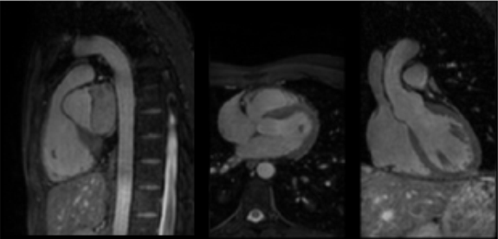
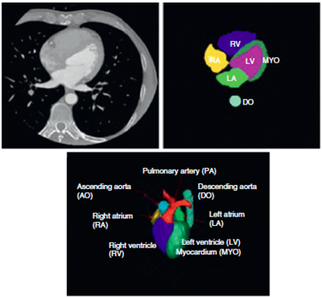
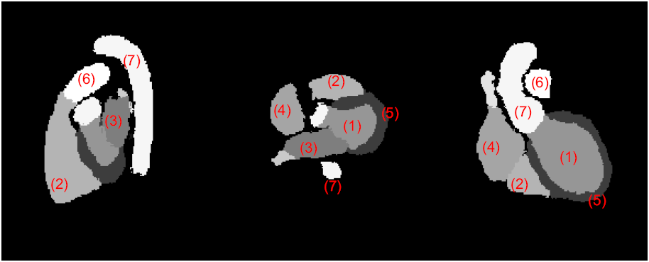
Whole heart segmentation
Cardiac MR
Cardiac CT
3D rendering
Left ventricle (1), right ventricle (2), left atrium (3), right atrium, (4) myocardium (5), pulmonary artery (6), and aorta (7).
X Zhuang: Challenges and Methodologies of Fully Automatic Whole Heart Segmentation: A Review, Journal of Healthcare Engineering 4 (2), 223–260, 2013

Slide 5
Whole heart segmentation
Challenges
shape variations
indistinct boundaries
appearance
X Zhuang: Challenges and Methodologies of Fully Automatic Whole Heart Segmentation: A Review, Journal of Healthcare Engineering 4 (2), 223–260, 2013

Slide 6
Whole heart segmentation
Challenges
Left enhanced Whole heart enhanced Right enhanced
X Zhuang: Challenges and Methodologies of Fully Automatic Whole Heart Segmentation: A Review, Journal of Healthcare Engineering 4 (2), 223–260, 2013
[Ecabert et al. IEEE Trans. Med. Imag. 27 (9), 1189-1201, 2008.]

Slide 7
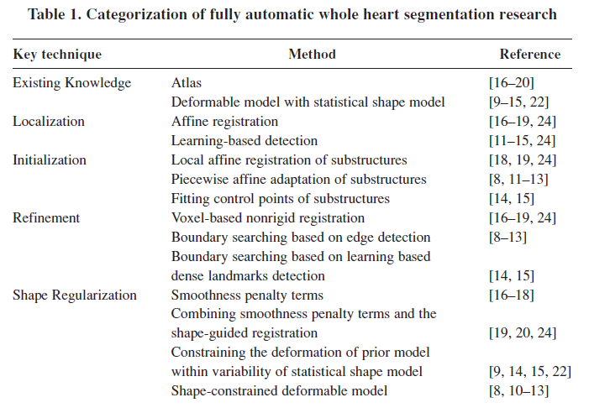
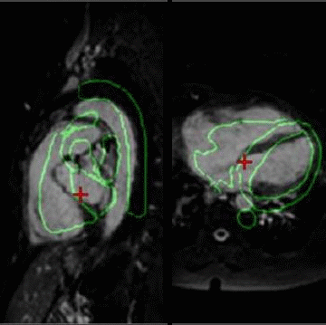
Whole heart segmentation
Methods
X Zhuang: Challenges and Methodologies of Fully Automatic Whole Heart Segmentation: A Review, Journal of Healthcare Engineering 4 (2), 223–260, 2013

Slide 8
The proposed registration

Slide 9
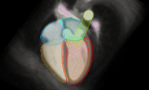
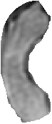
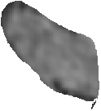
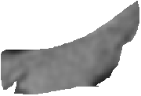
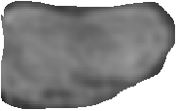
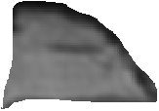
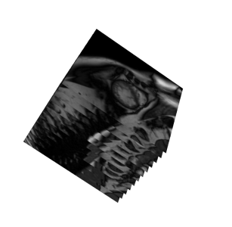
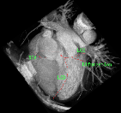
Whole heart segmentation
Our method: atlas-based segmentation
Atlas intensity & label images
Substructures of the heart
Target MR/CT image
global affine registration
locally affine registration
segmentation propagation
FFD nonrigid registration
deformation
Hierarchical registration scheme
Zhuang, X., et al.: A Registration-Based Propagation Framework for Automatic Whole Heart Segmentation of Cardiac MRI.
IEEE Trans. Med. Imag. 29 (9), 1612-1625, 2010.

Slide 10
Whole heart segmentation
Visual results (3 poor cases from the 37)
Three segmentation cases. Subject-119 is a healthy case while subject-10 and subject-43 are pathological cases. The Whole Heart segmentation errors (RMS) for each subject are 2.39 mm, 3.17 mm, and 2.86 mm respectively. GD: gold standard segmentation; PS: propagated segmentation.
Zhuang, X., et al.: A Registration-Based Propagation Framework for Automatic Whole Heart Segmentation of Cardiac MRI.
IEEE Trans. Med. Imag. 29 (9), 1612-1625, 2010.

Slide 11
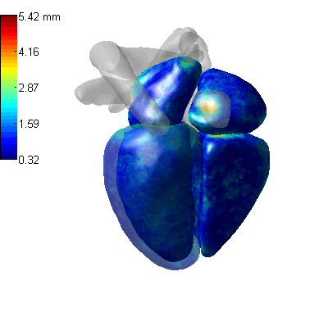
Whole heart segmentation
Quantitative results on 37 subjects
Color map of surface-to-surface
errors of the whole heart
segmentation
The big errors mainly distributed
to the area of connections
between substructures
Zhuang, X., et al.: A Registration-Based Propagation Framework for Automatic Whole Heart Segmentation of Cardiac MRI.
IEEE Trans. Med. Imag. 29 (9), 1612-1625, 2010.

Slide 12




Whole heart segmentation
Single atlas VS Multiple atlases
Atlas
Atlas
Atlas
Atlas
Atlas
Target image
Atlas
Atlas
Atlas
Atlas
Atlas
Atlas registration
Atlas
Atlas
Atlas
Atlas
Atlas
Atlas
Segmentation propagation
Result
Atlas
Atlas
Atlas
Atlas
Atlas
Atlas
Atlas
Atlas
Atlas

Slide 13
Content of whole heart segmentation
Concepts
Definition
Challenges
Atlas-based segmentation
Multi-atlas segmentation (MAS)
Multi-atlas segmentation (MAS)
Atlas ranking and selection
Multi-modality multi-atlas segmentation
Multi-scale patches for multi-level ranking in local weighted label fusion

Slide 14
Whole heart segmentation
Multi-atlas segmentation without atlas selection
Atlas 1
Seg 1
Atlas 2
Seg 2
Label Fusion
Registration and propagation
Atlas 2
Seg 1
Seg M
result
. . .
. . .
Atlas N
Seg N
Target image
[X Zhuang, et al.: Multiatlas whole heart segmentation of CT data using conditional entropy for atlas ranking and selection. Medical Physics 42 (7), 3822-3833, 2015]

Slide 15
Whole heart segmentation
Naive fusion VS good atlas selection & fusion
Dice score
Notes:
Dice score

Slide 16
Whole heart segmentation
Conditional entropy for atlas selection
H denotes entropy, p(i,l) is the joint probability of the intensity value i and label l, and p(l) is the marginal probability of label l.
Atlas 1
Seg 1
Atlas 2
Seg 2
good ones
Label Fusion
Registration and propagation
Atlas 2
Seg 1
Seg M
result
. . .
. . .
Atlas N
Target image
Seg N
Atlas ranking and selection
[X Zhuang, et al.: Multiatlas whole heart segmentation of CT data using conditional entropy for atlas ranking and selection. Medical Physics 42 (7), 3822-3833, 2015]
Notes:
where H denotes entropy, p(i,l) is the joint probability of the intensity value i and label l, and p(l) is the marginal probability of label l.

Slide 17
Multi-atlas segmentation (MAS)
Conditional entropy for atlas selection
Dice score
[X Zhuang, et al.: Multiatlas whole heart segmentation of CT data using conditional entropy for atlas ranking and selection. Medical Physics 42 (7), 3822-3833, 2015]

Slide 18
Whole heart segmentation
Data
Thirty cardiac CTA images from 30 patients
In plane resolution: 0.44×0.44 mm,
Mean slice thickness: 0.60 mm.
Leave one out: one as target, the other 29 as atlas database
[X Zhuang, et al.: Multiatlas whole heart segmentation of CT data using conditional entropy for atlas ranking and selection. Medical Physics 42 (7), 3822-3833, 2015]

Slide 19
Whole heart segmentation
MAS (conditional entropy for atlas ranking)
[X Zhuang, et al.: Multiatlas whole heart segmentation of CT data using conditional entropy for atlas ranking and selection. Medical Physics 42 (7), 3822-3833, 2015]

Slide 20
Multi-modality and multi-atlas
Single-modality VS multi-modality atlases
MR Atlas
MR Atlas
MR Atlas
Target MR image
CT Atlas
MR Atlas
CT Atlas
MR Atlas
CT Atlas
MR Atlas
CT Atlas
MR Atlas
CT Atlas
MR Atlas
CT Atlas
MR Atlas
CT Atlas
MR Atlas
CT Atlas
MR Atlas
CT Atlas
MR Atlas
CT Atlas
CT Atlas
MR Atlas
Atlas registration
CT Atlas
CT Atlas
MR Atlas
CT Atlas
CT Atlas
CT Atlas
CT Atlas
CT Atlas
CT Atlas
CT Atlas
CT Atlas
CT Atlas
CT Atlas
Segmentation propagation
Result
CT Atlas
CT Atlas
CT Atlas
CT Atlas
CT Atlas
CT Atlas
CT Atlas
CT Atlas
CT Atlas
CT Atlas
CT Atlas
CT Atlas
CT Atlas
CT Atlas
CT Atlas
CT Atlas
CT Atlas
CT Atlas
CT Atlas
CT Atlas
CT Atlas
Other M atlas
CT Atlas

Slide 21
Multi-modality multi-atlas
Multi-modality multi-atlas segmentation (M³AS)
The more atlases the better performance of MAS
Increase size of atlas database using multi-modality atlases
Challenges of M³AS
(1) Atlas ranking criterion
(2) Local similarity at patch level
-- for local weighted label fusion
[X Zhuang and J Shen: Multi-scale patch and multi-modality atlases for whole heart segmentation of MRI,
Medical Image Analysis, vol.31, pp.77–87 (2016) ]

Slide 22


Multi-modality multi-atlas
(1) Atlas ranking criterion
Which atlas is better
Intensity difference | Mutual Information | Accuracy (Dice score)
8.6*10^6 | 1.322 | 0.856
10.8*10^6 | 1.281 | 0.901
VS
[X Zhuang and J Shen: Multi-scale patch and multi-modality atlases for whole heart segmentation of MRI,
Medical Image Analysis, vol.31, pp.77–87 (2016) ]
Notes:
Which atlas is better ?

Slide 23
Multi-modality multi-atlas
(1) Atlas ranking criterion – conditional entropy
Which atlas is better
Minus conditional entropy | Accuracy (Dice score)
1.0388 | 0.856
1.3217 | 0.901
VS
[X Zhuang and J Shen: Multi-scale patch and multi-modality atlases for whole heart segmentation of MRI,
Medical Image Analysis, vol.31, pp.77–87 (2016) ]
Notes:
Which atlas is better ?

Slide 24
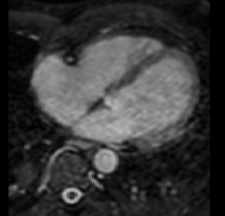
Multi-modality multi-atlas
(2) Local similarity at patch level
Given a patch window in patch-based matching
Left ventricle
Left atrium
Right ventricle
Right atrium
[X Zhuang and J Shen: Multi-scale patch and multi-modality atlases for whole heart segmentation of MRI,
Medical Image Analysis, vol.31, pp.77–87 (2016) ]
Notes:
Left ventricle

Slide 25



Multi-modality multi-atlas
(2) Local similarity at patch level
Given a patch window in patch-based matching
Multi-Scale Patch
strategy
[X Zhuang and J Shen: Multi-scale patch and multi-modality atlases for whole heart segmentation of MRI,
Medical Image Analysis, vol.31, pp.77–87 (2016) ]

Slide 26
Multi-modality multi-atlas
[X Zhuang and J Shen: Multi-scale patch and multi-modality atlases for whole heart segmentation of MRI,
Medical Image Analysis, vol.31, pp.77–87 (2016) ]

Slide 27
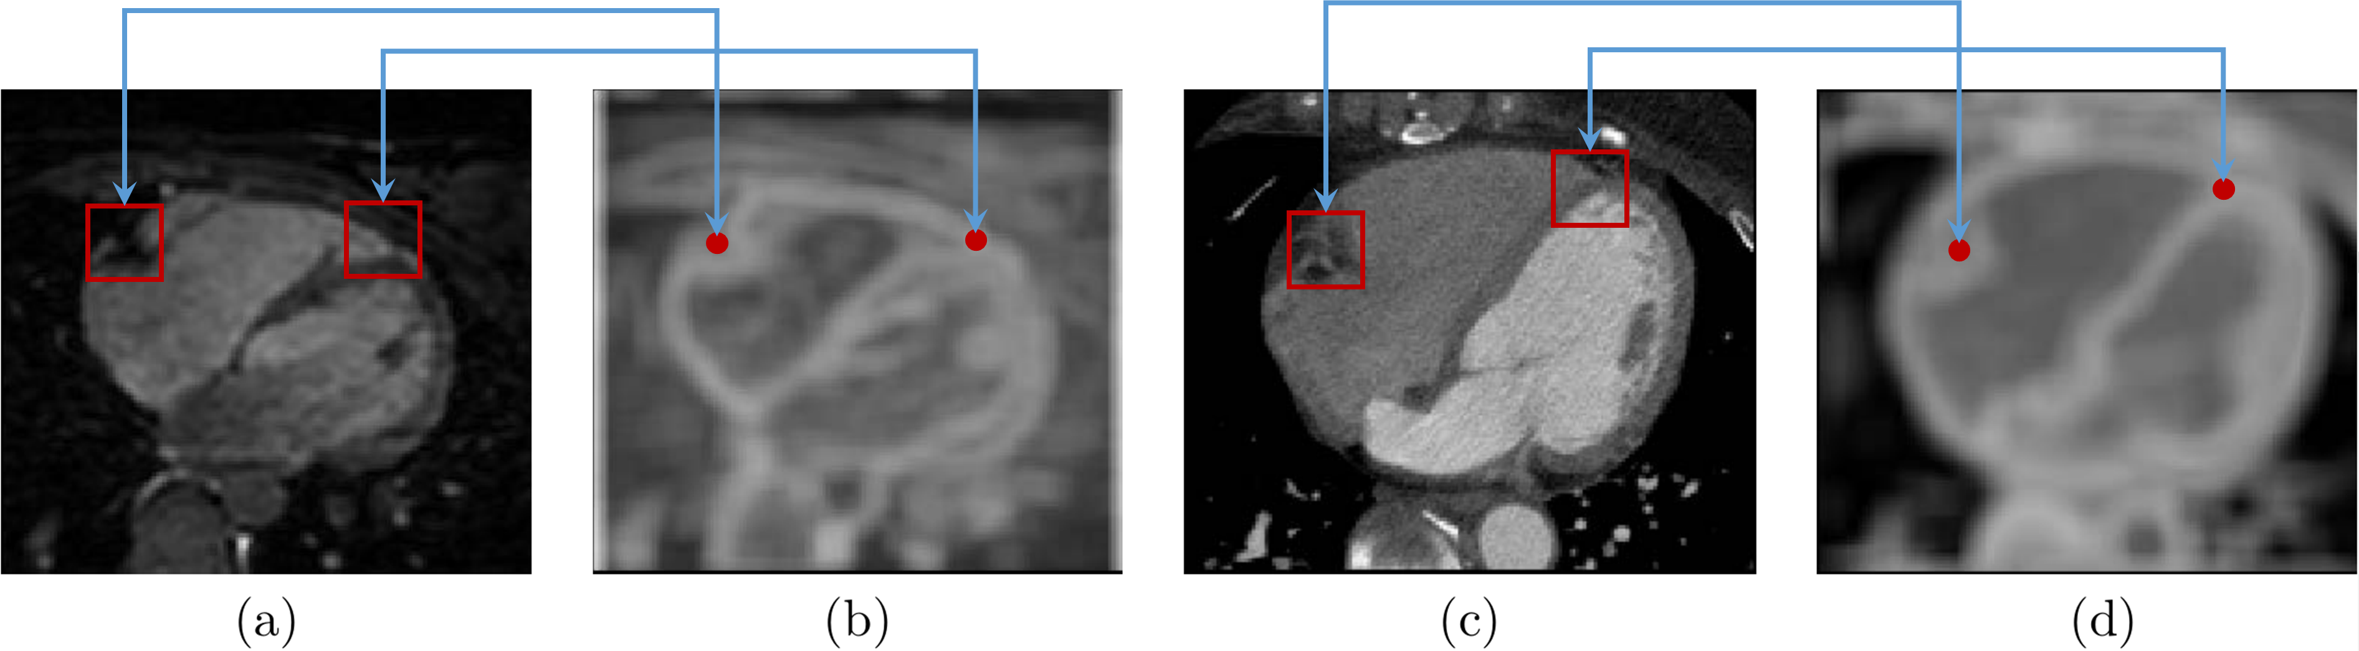
Multi-modality multi-atlas
(2) Local similarity at patch level
Entropy image
Conditional probability of images: p_{x}(I|A)=p(I(x)|A(x))
--- works better, pls referred to the paper for details
(a) an axial-view image of a cardiac MRI; (b) the corresponding EI of (a);
(c) an axial-view image of a cardiac CT; (d) the corresponding EI of (c).
[X Zhuang and J Shen: Multi-scale patch and multi-modality atlases for whole heart segmentation of MRI,
Medical Image Analysis, vol.31, pp.77–87 (2016) ]
Notes:
Left ventricle

Slide 28
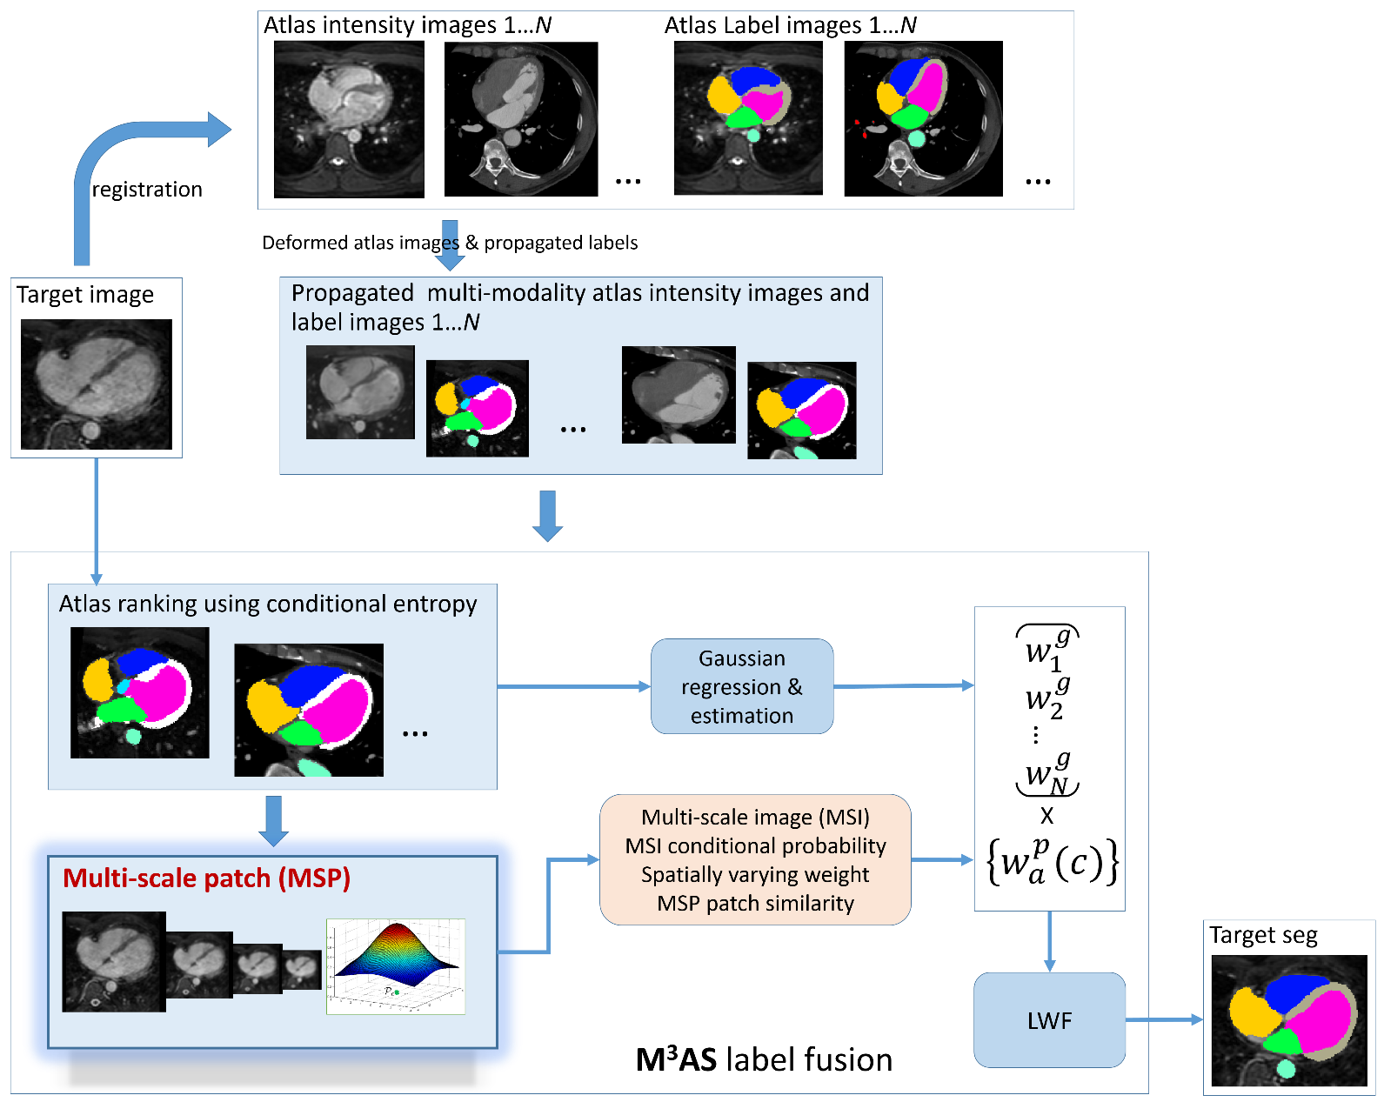
Multi-modality multi-atlas (M³AS)
Registration
for
segmentation
propagation
Ranking
for
multi-modality
atlases
local weighted
label fusion
Multi-level
ranking
multi-modality
local patches
[X Zhuang and J Shen: Multi-scale patch and multi-modality atlases for whole heart segmentation of MRI,
Medical Image Analysis, vol.31, pp.77–87 (2016) ]

Slide 29
M³AS: MRI seg results
Data
MRI: 20 sets; CT: 20 sets
Two-fold cross validation strategy was used, by dividing the 20 MRI data into two sets, one be the test set and the other be the atlas set.
All of the twenty cardiac CT data were used as atlases to form a thirty-subject, multi-modality atlas set.
[X Zhuang and J Shen: Multi-scale patch and multi-modality atlases for whole heart segmentation of MRI,
Medical Image Analysis, vol.31, pp.77–87 (2016) ]

Slide 30
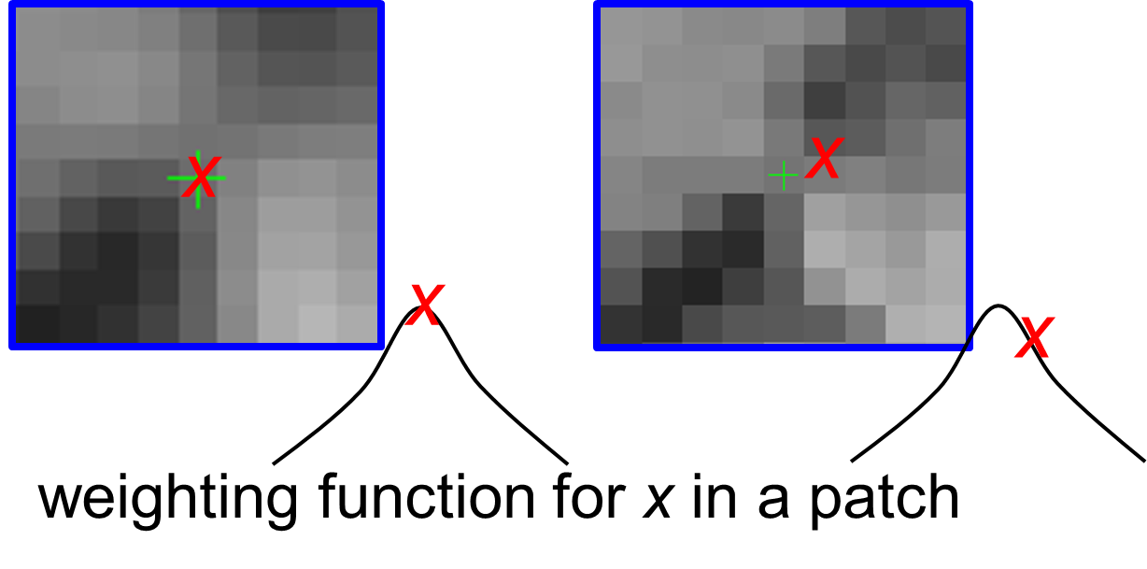
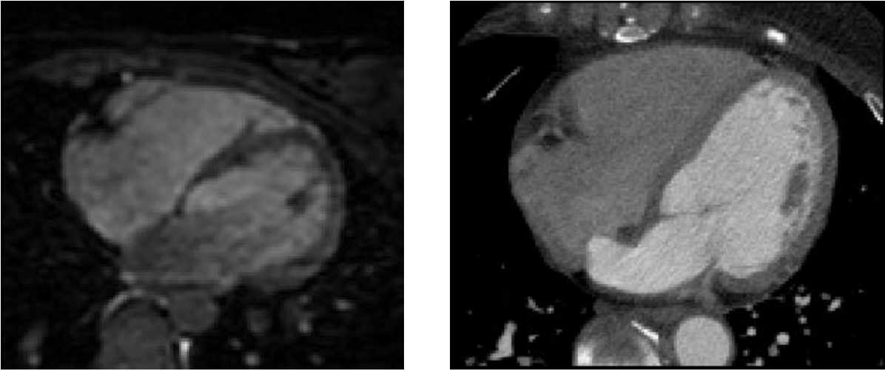
Study of patch strategies
[X Zhuang and J Shen: Multi-scale patch and multi-modality atlases for whole heart segmentation of MRI,
Medical Image Analysis, vol.31, pp.77–87 (2016) ]

Slide 31
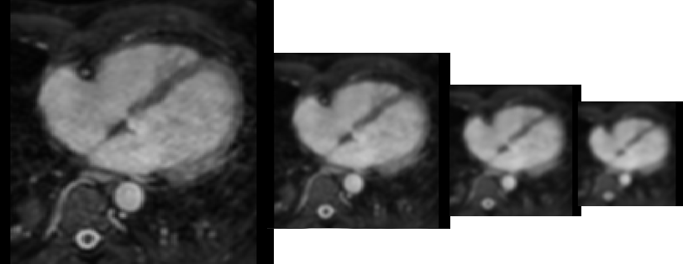
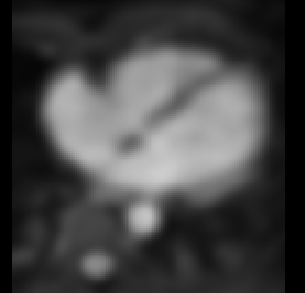
Study of patch strategies
Number of scales
Compare with joint label fusion
[X Zhuang and J Shen: Multi-scale patch and multi-modality atlases for whole heart segmentation of MRI,
Medical Image Analysis, vol.31, pp.77–87 (2016) ]
Notes:
Number of scales

Slide 32
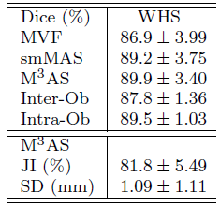
M³AS: MRI seg results
Performance of the proposed method
Single-modality multi-atlas segmentation using proposed label fusion method
Conventional majority vote label fusion
Inter-observer variation
intra-observer variation
[X Zhuang and J Shen: Multi-scale patch and multi-modality atlases for whole heart segmentation of MRI,
Medical Image Analysis, vol.31, pp.77–87 (2016) ]
Notes:
Inter-observer variation
intra-observer varition

Slide 33
M³AS: MRI seg results
[X Zhuang and J Shen: Multi-scale patch and multi-modality atlases for whole heart segmentation of MRI,
Medical Image Analysis, vol.31, pp.77–87 (2016) ]

Slide 34
Related publication
X Zhuang and J Shen: Multi-scale patch and multi-modality atlases for whole heart segmentation of MRI, Medical Image Analysis, vol.31, pp.77-87 (2016)
X Zhuang, et al.: Multiatlas whole heart segmentation of CT data using conditional entropy for atlas ranking and selection. Medical Physics 42 (7), 3822-3833, 2015
X Zhuang et al.: A Registration-Based Propagation Framework for Automatic Whole Heart Segmentation of Cardiac MRI. IEEE Trans. Med. Imag. 29 (9), 1612-1625, 2010.
X Zhuang: Challenges and Methodologies of Fully Automatic Whole Heart Segmentation: A Review, Journal of Healthcare Engineering 4 (2), 223-260, 2013
Tool: zxhLabelFuse (download from: http://pan.baidu.com/s/1o67eKgM#path=%252Fzxhproj%252Fmsp_label_fusion_win)

